Slide 1
Week 3 Virtualization and Containerization
Dr Zhi Zhang

Slide 2
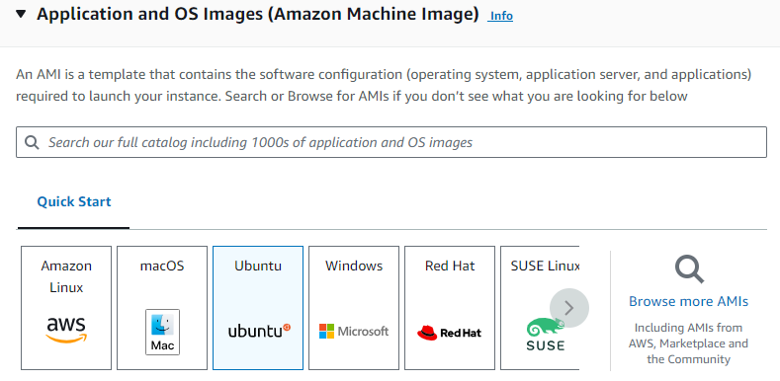
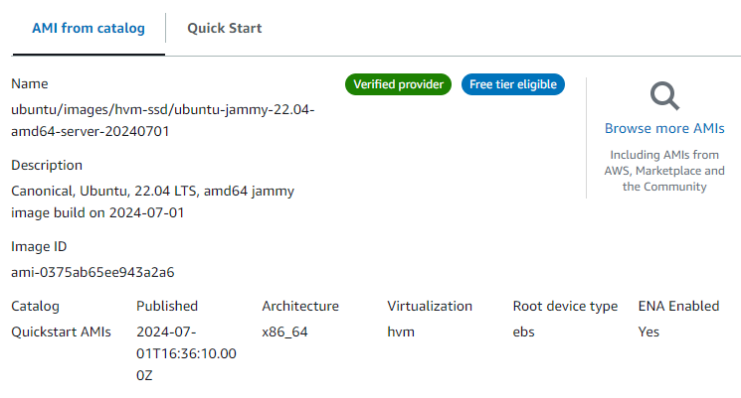
AWS EC2

Slide 3
Overview
Operating System Concepts
Virtualization
Containerization

Slide 4
Operating System Concepts
Process scheduling
Virtual memory

Slide 5
What is a process?
A process is a program that is executed.
It is a basic unit of execution in an OS.

Slide 6
What is a process?
A process is a program that is executed
It is a basic unit of execution in an OS.
Process scheduling (time-sharing)
Each process is scheduled and executed within their time share.
The number of processes can be much larger than that of the CPUs.

Slide 7
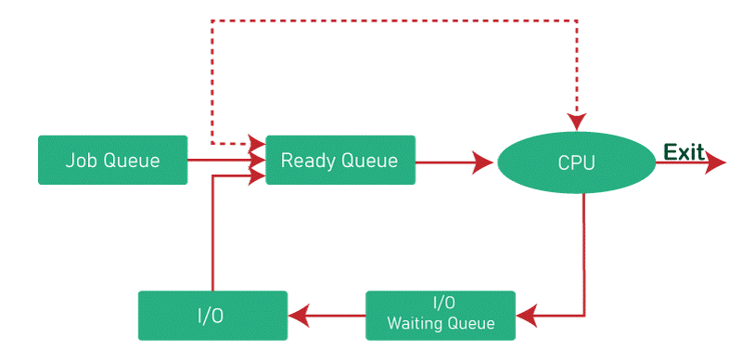
Process scheduling
https://byjus.com/gate/process-scheduling-in-operating-system-notes/

Slide 8
x86 Protection Rings (CPL)
CPU Privilege Level (CPL)
x86 has four protection levels (rings) /CPU privilege levels (CPLs).
ring 0 – “Kernel mode” (most privileged)
ring 3 – “User mode”
ring 1 & 2 – Other
Modern Oses such as Linux, Windows and MacOS only use ring 0 and ring 3.
“Kernel vs. user mode”

Slide 9
x86 Protection Rings (CPL)
OS
User Mode
User Processes
Kernel Mode
Process Scheduling
When CPU is in the user mode, it cannot execute privileged instructions (e.g., HLT).

Slide 10
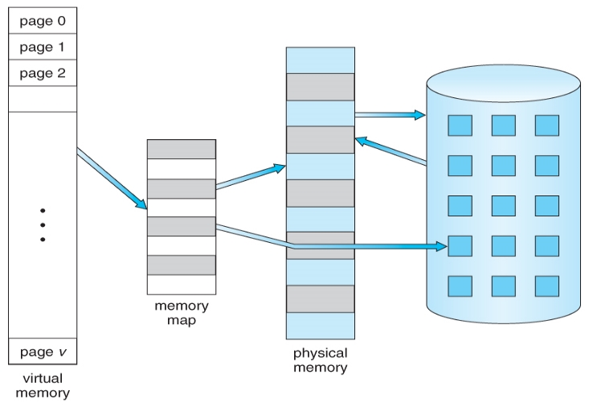
Virtual memory
Process A
Memory map
Physical memory
Disk
Virtual memory
https://www.cs.uic.edu/~jbell/CourseNotes/OperatingSystems/9_VirtualMemory.html

Slide 11
Paging/Swapping
Swapping
out
Process A
Swapping
in
paging
Memory map
Physical memory
(e.g., 2GB)
Disk
(e.g., 256GB)
Virtual memory
(e.g., 4GB)
https://www.cs.uic.edu/~jbell/CourseNotes/OperatingSystems/9_VirtualMemory.html

Slide 12
Virtual memory: 4GB
Virtual memory: 4GB
Physical memory: 2GB
?
Process A
Process B
Disk: 256GB

Slide 13
Virtual memory: 4GB
Virtual memory: 4GB
Physical memory: 2GB
Shared memory
Process A
Process B
Disk: 256GB

Slide 14
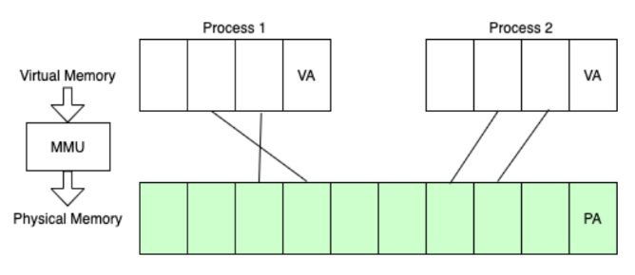
Memory map implementation
Page table:
In a modern OS, the OS uses a set of page tables to map/translate virtual memory within a process to their corresponding physical memory in main memory.
VA refers to virtual address, pointing to a page-aligned memory location in a virtual page.
PA refers to physical address, pointing to a page-aligned memory location in a physical page.
https://www.alibabacloud.com/blog/a-tribute-to-hackers-the-way-to-explore-memory-virtualization_599058

Slide 15
Page-aligned address
4KB
4KB
MMU
VA = 0x60001000
PA = 0x70001000
4KB
4KB
MMU
VA1 = 0x60001800
PA1 = ?
VA = 0x60001000
PA = 0x70001000

Slide 16
Page-aligned address
4KB
4KB
MMU
VA = 0x60001000
PA = 0x70001000
4KB
4KB
MMU
VA1 = 0x60001800
PA1 = 0x70001800
VA = 0x60001000
PA = 0x70001000

Slide 17
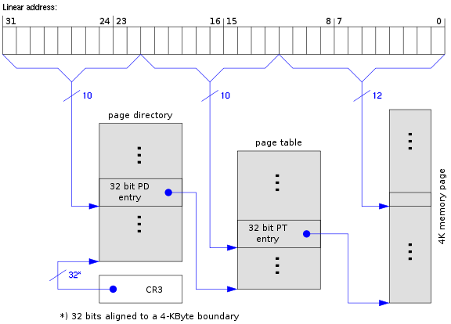
Memory map implementation: x86-32
Page table:
In a modern OS, the OS uses a set of page tables to map/translate virtual memory within a process to their corresponding physical memory in main memory.
32-bit version of x86, known as IA-32 (Intel Architecture 32-bit) or x86-32, where 32-bit virtual/linear addresses are used.
https://www.cs.virginia.edu/~bjc8c/class/cs6456-s20/slides/01-intro.pptx

Slide 18
Memory map implementation: x86-32
Page table:
In a modern OS, the OS uses a set of page tables to map/translate virtual memory within a process to their corresponding physical memory in main memory.
32-bit version of x86, known as IA-32 (Intel Architecture 32-bit) or x86-32, where 32-bit virtual/linear addresses are used.
2-level page tables
https://www.cs.virginia.edu/~bjc8c/class/cs6456-s20/slides/01-intro.pptx

Slide 19
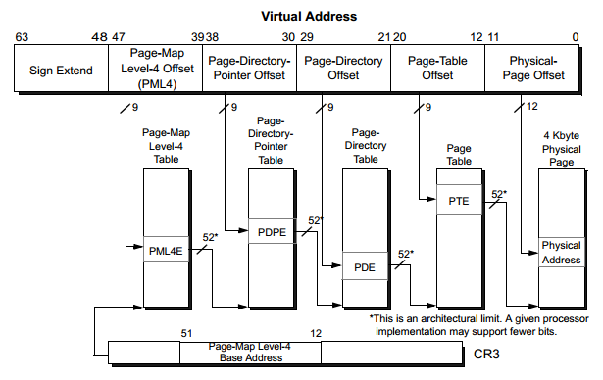
Memory map implementation: x86-64
https://superuser.com/questions/1740680/are-page-tables-under-utilized-in-x86-systems

Slide 20
What is virtualization?
Virtualization is the ability to run multiple operating systems on a single physical machine and share the underlying hardware resources [1]
Allows one computer software (called Virtual Machine Monitor or Hypervisor) to provide the appearance of many computers (called virtual machines).
[1] VMWare white paper, Virtualization Overview

Slide 21
Characteristics for VMM
Full control over hardware resources
Hardware virtualization
Near-native performance

Slide 22
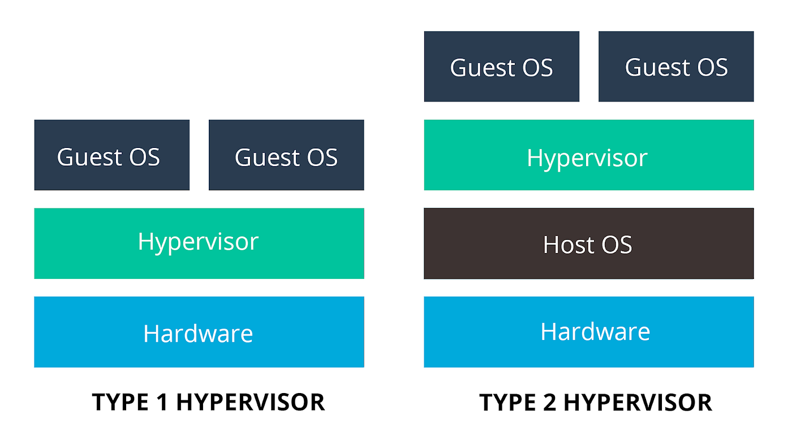
VMM Types
Bare-metal/Native Architecture
Hosted Architecture

Slide 23
VMM Types
Bare-metal/Native Architecture
Hosted Architecture
Examples: KVM, Xen, Hyper-V
Examples:?

Slide 24
VMM Types
Bare-metal/Native Architecture
Hosted Architecture
Examples: KVM, Xen, Hyper-V
Examples: VirtualBox, UTM, Vmware

Slide 25
VMM Types
Bare-Metal/Native Architecture
VMM or Hypervisor is installed directly on hardware as the most privileged software.
Acknowledged as preferred architecture for mainstream public clouds
Examples: KVM, Xen, Hyper-V
Hosted Architecture
Install as an application on an existing host OS, e.g., Windows, Linux, MacOS
Examples: Virtualbox, UTM, Vmware

Slide 26
VMM implementation on x86-64
Hardware support: Intel and AMD assist virtualization
Intel VT-x and AMD SVM: CPU and memory virtualization
Intel VT-d and AMD Vi: Device virtualization

Slide 27
CPU non-virtualization
Ring3
Ring2
Ring1
Ring0

Slide 28
CPU virtualization: Intel VT-x & AMD SVM
Host/VMX root mode
Guest/VMX non-root mode
Two VT-x operating modes
Less-privileged mode (guest or VMX non-root) for guest OSes
More-privileged mode (host or VMX root) for VMM
Ring3
Ring3
Ring2
Ring2
Ring1
Ring1
Ring0
Ring0

Slide 29
CPU virtualization: Intel VT-x & AMD SVM
Guest OS
Guest OS
VMX root mode
VMM runs directly on hardware
VMX non-root mode
Guest OS runs directly on hardware with a few exceptions
e.g., privileged/sensitive instructions.
Ring 3
Apps
Apps
VMX non-root
Ring 0
Kernel
Kernel
Ring 3
VM management utilities
VMX Root
Ring 0
Hypervisor core
VMM

Slide 30
CPU virtualization: Intel VT-x & AMD SVM
Guest OS
Guest OS
Two transitions
VM entry to non-root operation
VM exit to root operation
Ring 3
Apps
Apps
VMX non-root
Ring 0
Kernel
Kernel
VM Exit
VM Entry
VMX Root
Ring 3
VM management utilities
Ring 0
Hypervisor core
VMM

Slide 31
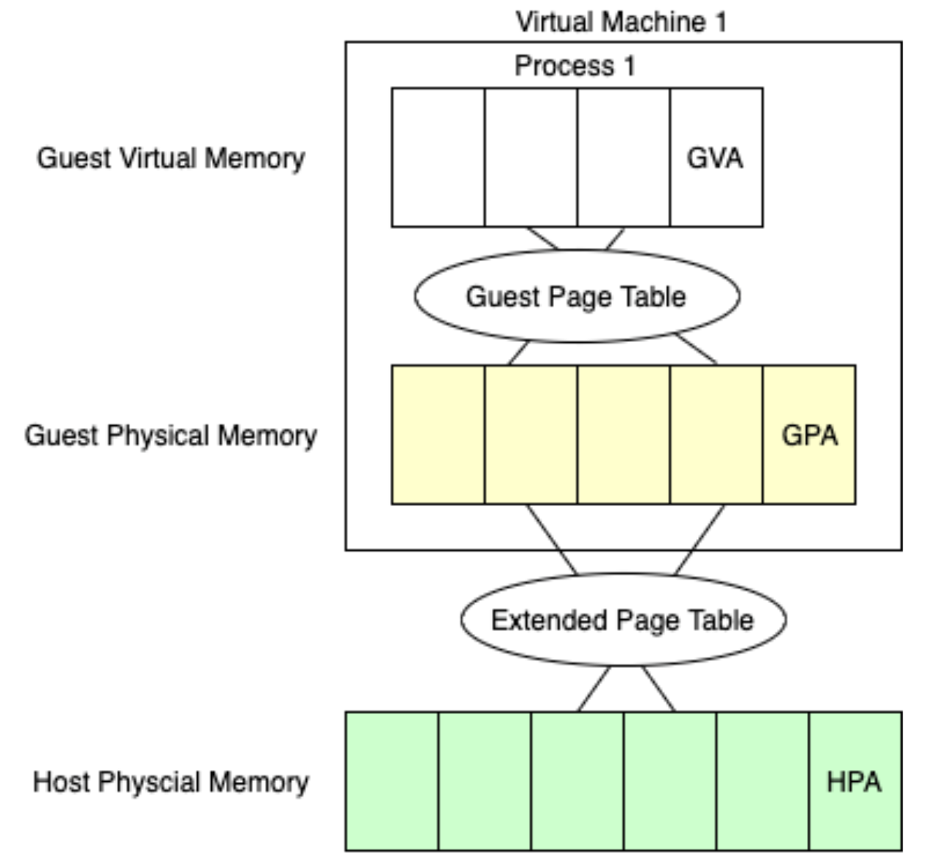
Memory virtualization: Intel EPT & AMD NPT
https://www.alibabacloud.com/blog/599058

Slide 32
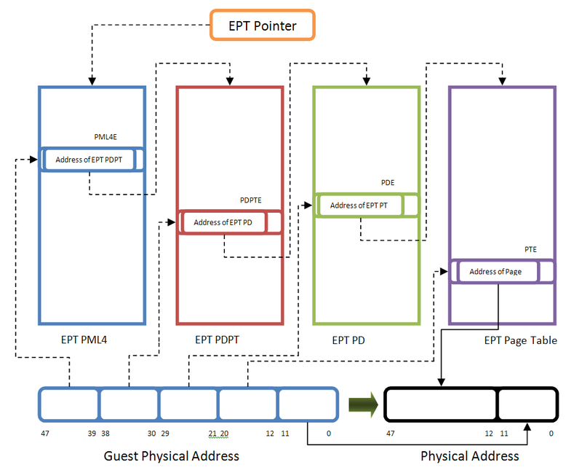
Memory virtualization: Intel EPT & AMD NPT
https://rayanfam.com/topics/hypervisor-from-scratch-part-4/#hardware-assisted-paging-extended-page-table

Slide 33
Containers
A container is a sandboxed process running on a host OS that is isolated from all other processes running on that host OS [2]
A container image is a stand-alone and executable software package (including software dependencies, binaries, etc) that contains everything needed to run specific user applications.
A container is a runnable instance of the image.
[2] https://docs.docker.com/get-started/

Slide 34

Containers
Container
VM
https://www.weave.works/blog/a-practical-guide-to-choosing-between-docker-containers-and-vms

Slide 35
Containerization vs. Virtualization
Granularity
Containers are an abstraction of the process layer and VMs are a simulation of the hardware layer.
Overhead
Required resources: containers are created to run one application and VMs support a whole OS.
Efficiency: containers are launched to run an application. VMs need to boot up an entire OS.
Security/Isolation
Containers are isolated from each other at the process level. VMs are isolated at the OS level.

Slide 36
Backbones of containers
namespaces
cgroups
copy-on-write filesystem

Slide 37
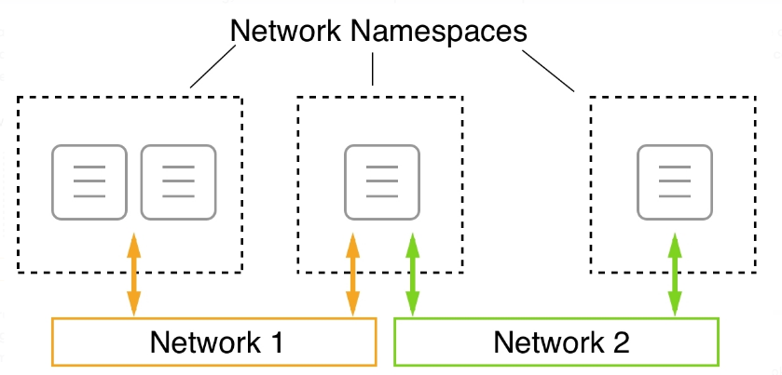
namespaces: limits what a container can see
Provide containers with their own view of system resources (e.g., network)
container
https://subscription.packtpub.com/book/cloud-and-networking/9781838827472/13/ch13lvl1sec97/running-in-an-existing-network-namespace

Slide 38
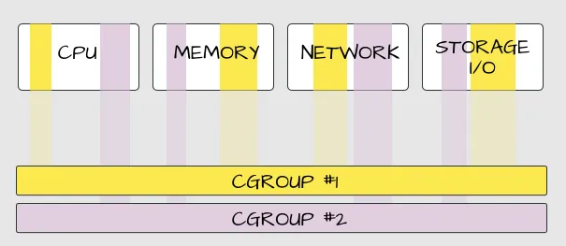
cgroups: limits how much a container can use
Control Groups: manage resource usage and limits for processes within a container.

Slide 39
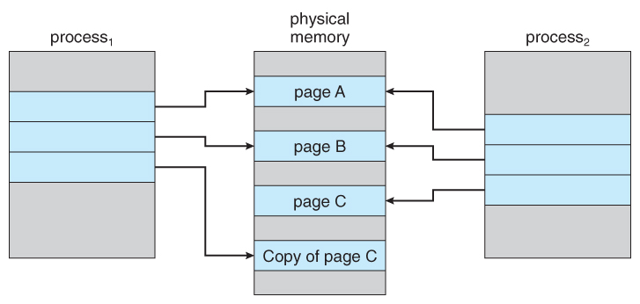
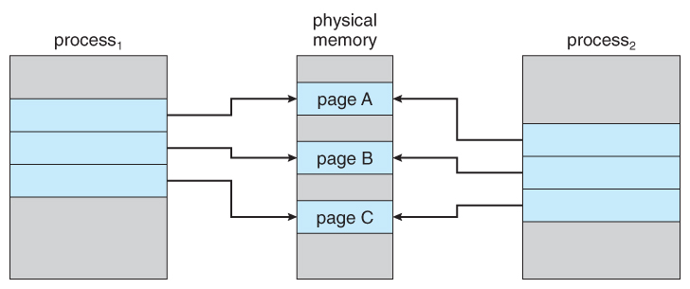
copy-on-write filesystem: lightweight container
Allow containers to share read-only underlying OS files. If a container write-access a file, a copy is created and updated accordingly.
Similar to the copy-on-write fork
Which process modified page C?
https://www.cs.uic.edu/~jbell/CourseNotes/OperatingSystems/9_VirtualMemory.html

Slide 40
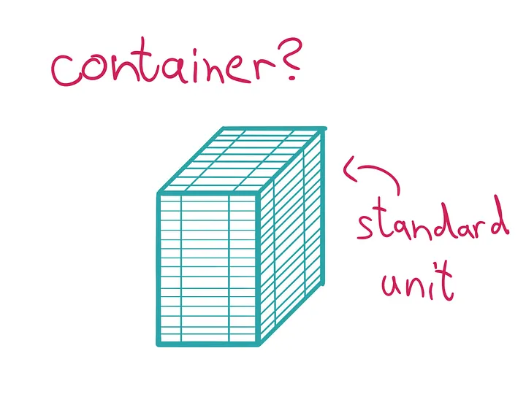
Docker container
Docker provides an interface on top of the techniques
Popularized containers (a standard unit of software)
https://medium.com/@saschagrunert/demystifying-containers-part-i-kernel-space-2c53d6979504

Slide 41
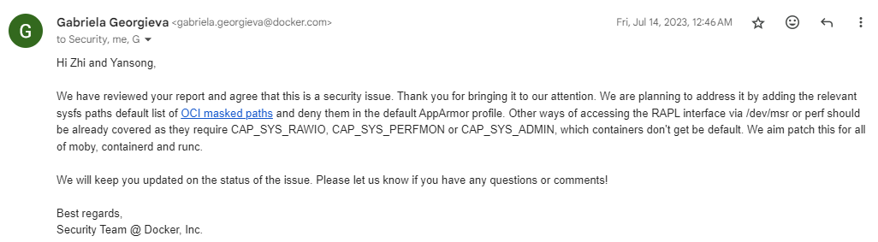
Docker container

Slide 42
Docker cheatsheet
docker run – Runs a command in a new container.
docker start – Starts one or more stopped containers
docker stop – Stops one or more running containers
docker build – Builds an image form a Docker file
docker pull – Pulls an image or a repository from a registry
docker push – Pushes an image or a repository to a registry
docker export – Exports a container’s filesystem as a tar archive
docker exec – Runs a command in a run-time container
docker search – Searches the Docker Hub for images
docker attach – Attaches to a running container
docker commit – Creates a new image from a container’s changes

Slide 43
Practice Question
[7 marks] Q1: Describe what virtualization is. Describe three types of virtualization (Language, Operating System and Hardware) and their respective attribute.

Slide 44
Practice Question
[7 marks] Q1: Describe what virtualization is. Describe three types of virtualization (Language, Operating System and Hardware) and their respective attribute.
[1 mark] Virtualization is a technology that allows multiple virtual instances of hardware/software resources (e.g., operating systems) to run.
[2 marks] Language virtualization:
[2 marks] Operating system virtualization:
[2 marks] Hardware virtualization:

Slide 45
Practice Question
[7 marks] Q1: Describe what virtualization is. Describe three types of virtualization (Language, Operating System and Hardware) and their respective attribute.
[1 mark] Virtualization is a technology that allows multiple virtual instances of hardware/software resources (e.g., operating systems) to run.
[2 marks] Language virtualization: provides a virtual runtime environment (e.g., Python interpreter) that allows code written in a specific programming language (e.g., Python) to execute.
Cross-OS: code can be executed in a virtual runtime environment across different OSes without modification.
[2 marks] Operating system virtualization:
[2 marks] Hardware virtualization:

Slide 46
Practice Question
[7 marks] Q1: Describe what virtualization is. Describe three types of virtualization (Language, Operating System and Hardware) and their respective attribute.
[1 mark] Virtualization is a technology that allows multiple virtual instances of hardware/software resources (e.g., operating systems) to run.
[2 marks] Language virtualization: provides a virtual runtime environment (e.g., Python interpreter) that allows code written in a specific programming language (e.g., Python) to execute.
Cross-OS: code can be executed in a virtual runtime environment across different OSes without modification.
[2 marks] Operating system virtualization: allows multiple isolated user-space environments (e.g., docker containers) to run on top of a single OS kernel (e.g., Linux kernel).
Limited Isolation: while user-space environments are isolated, they share the same OS kernel, which means a vulnerability in the kernel could affect all user-space environments.
[2 marks] Hardware virtualization:

Slide 47
Practice Question
[7 marks] Q1: Describe what virtualization is. Describe three types of virtualization (Language, Operating System and Hardware) and their respective attribute.
[1 mark] Virtualization is a technology that allows multiple virtual instances of hardware/software resources (e.g., operating systems) to run.
[2 marks] Language virtualization: provides a virtual runtime environment (e.g., Python interpreter) that allows code written in a specific programming language (e.g., Python) to execute.
Cross-OS: code can be executed in a virtual runtime environment across different OSes without modification.
[2 marks] Operating system virtualization: allows multiple isolated user-space environments (e.g., docker containers) to run on top of a single OS kernel (e.g., Linux kernel).
Limited Isolation: while user-space environments are isolated, they share the same OS kernel, which means a vulnerability in the kernel could affect all user-space environments.
[2 marks] Hardware virtualization: creates multiple virtual machines sharing a single physical server.
VM Snapshots: allows saving the current state of a VM
Live VM Migration: enables moving runtime VMs between physical servers seamlessly.

